Slide 1

INDIAN INSTITUTE OF TECHNOLOGY GANDHINAGAR
PG Diploma in AI-ML and Agentic AI Engineering · Cohort 2 · Build 1
BRIEF A · GROWTH · GROUP 9
Which part of Kalpa Health's business is short?
Test volume grew 5.0% (457,230 vs 435,430 tests, H1 2026 vs H1 2025, six cities) against a plan of 18.4%. The shortfall sits in the clinic channel (−11.9%), while home collection grew 37.5%.
[Nisha Kherala] · [Aditya Kr Sharma] · [Vasudev Kamath Mundkur]
Notes:
Say the question and the claim, nothing else. Twenty seconds. The cover is read, not presented.

Slide 2
1 · THE QUESTION
1 / 6
The question: where did the 13 points go?
Her words:
“Show me the part of my business that is short, by how much, and where.”
Our translation:
The tree: tests = patients × visits per patient × tests per visit, H1 2026 against H1 2025, then split by city and channel and set against the plan (set per city on last year's volume).
The decision it drives:
Whether to cut targets and headcount city by city, or to fix one channel everywhere. If clinics are short in every city, a city-by-city cut is the wrong tool.
Indian Institute of Technology Gandhinagar · PG Diploma in AI-ML and Agentic AI Engineering · Cohort 2 · Build 1
Notes:
One minute. Her words first, then the translation in one line, then the decision. If the panel does not know what decision hangs on your answer by the end of this slide, nothing after it matters.

Slide 3
2 · THE PICTURE
2 / 6
The tree, with both years in every box
Patients served
94,477 → 98,025
+3.8%
Also in H1 2025
— → 31,034
H1 2026 only
Not in H1 2025
— → 66,991
H1 2026 only
+
Test volume
435,430 → 457,230
+5.0%
×
Visits per patient
2.006 → 1.986
−1.0%
Industry tree: patients × tests per patient × revenue per test
98,025 patients × 4.664 tests each × ₹689 (H1 2025: 94,477 × 4.609 × ₹639)
Branches multiply back to the total. New / returning split is H1 2026 only: the data starts in January 2025.
×
Tests per visit
2.298 → 2.348
+2.2%
Revenue, booked at list price
₹27.8 cr → ₹31.5 cr (+13.2%)
Test volume
435,430 → 457,230
Revenue per test
₹639 → ₹689 (+7.8%)
=
×
Indian Institute of Technology Gandhinagar · PG Diploma in AI-ML and Agentic AI Engineering · Cohort 2 · Build 1
Notes:
Ninety seconds. Point at two numbers on the picture, the two that carry the claim. Do not read the diagram aloud.

Slide 4
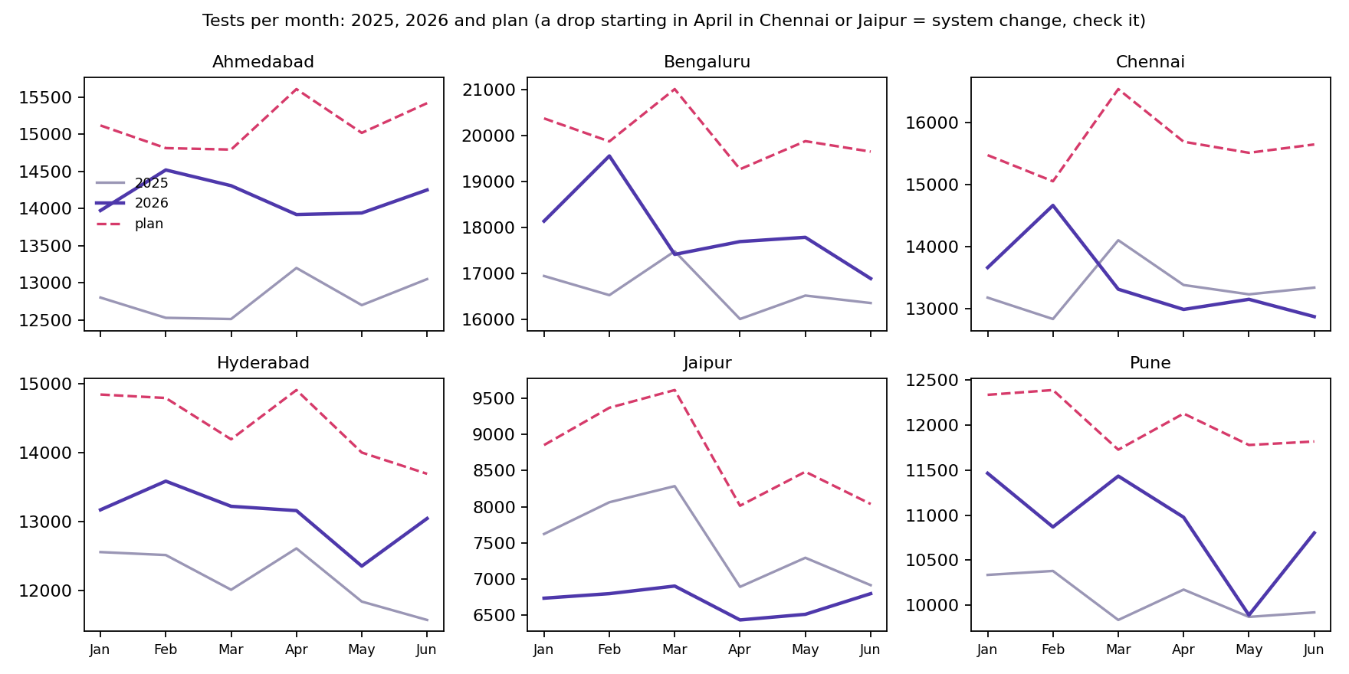

Slide 5
3 · THE CLAIM
3 / 6
One sentence for the board
Test volume grew 5.0% in H1 2026 against H1 2025 (457,230 vs 435,430 tests, six cities) versus a plan of 18.4%: the 13.4-point shortfall sits in the clinic channel, which fell 11.9% while home collection grew 37.5%, and clinic is below plan in all six cities.
Indian Institute of Technology Gandhinagar · PG Diploma in AI-ML and Agentic AI Engineering · Cohort 2 · Build 1
Notes:
Say the sentence. Stop. Count to two. The silence is the point; the slide has one sentence on it so the room reads it twice.

Slide 6
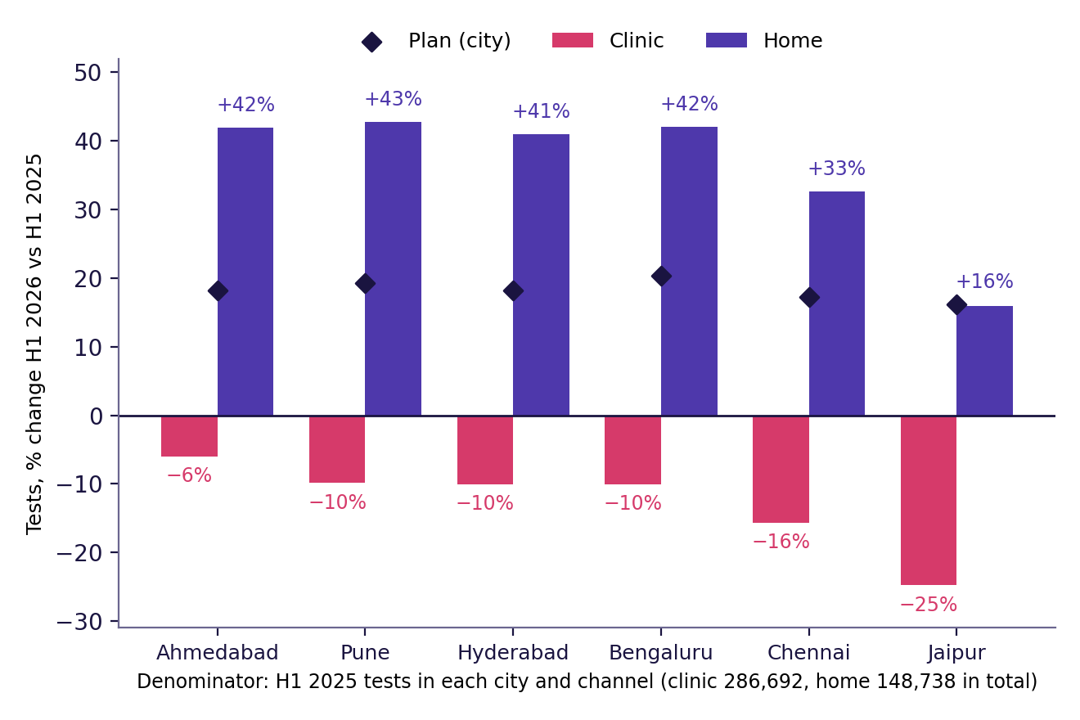
4 · THE EVIDENCE
4 / 6
Channel wise breakdown of City
1. Growth: 457,230 of 435,430 tests in H1 2025 = +5.0% (H1 2026 vs H1 2025, six cities). Plan +18.4%: 58,510 tests, 13.4 points, short.
2. Channel: clinic 252,678 of 286,692 = −11.9% (−34,014 tests); home 204,552 of 148,738 = +37.5% (+55,814). Against the plan spread by last year's mix: clinic −20.0 points, home +6.5.
Indian Institute of Technology Gandhinagar · PG Diploma in AI-ML and Agentic AI Engineering · Cohort 2 · Build 1
Notes:
Two minutes. Each number with its denominator, said aloud. Point at the chart's axis label where the denominator is written. This is the slide the finance controller checks against the decisions log.

Slide 7
5 · THE CAVEAT AND THE ALTERNATIVE
5 / 6
What would change the claim, and what we rejected
The one thing that would change this claim:
The free home collection offer (₹150 fee waived, January to March). Clinic growth was −18.1% in those three months and −5.4% in the three after, so part of the clinic fall may be patients switching to home, not patients lost. If Q2's pace is the no-offer pace, the clinic shortfall is smaller by up to about 13 points of clinic growth (roughly 4 of the 13.4 network points, our estimate) and total demand is the real problem. We have not yet tested who used the offer.
The approach we rejected on the way here:
Counting from the results table (tests the lab ran), because it leaves out no-shows and cancellations (81.6% of booking rows) and the plan's monthly shape matches our booking count. It would have moved the headline by 0.03 points (+4.98% against +5.01%).
Indian Institute of Technology Gandhinagar · PG Diploma in AI-ML and Agentic AI Engineering · Cohort 2 · Build 1
Notes:
Ninety seconds. One caveat, chosen, with its size. One rejected alternative from the approach log. This slide is where the panel decides whether you thought or just computed.

Slide 8
6 · THE ACTION
6 / 6
The action, and the cost of being wrong
Do: report and plan clinic and home separately from now on, and start recovery in the clinic channel, Jaipur (clinic −24.8%) and Chennai (−15.6%) first. Hold the offer budget until a holdout test shows who the offer reached.
It costs: a four-week clinic review with the six city heads; a holdout skips the ₹150 waiver in a few catchments (the Q1 offer waived up to about ₹73.5 lakh across roughly 49,000 tagged bookings, to be verified).
If we are wrong, it costs: if the clinic loss is real and we wait a half-year, about 34,014 clinic tests (about ₹2.3 crore at ₹689 a test) stay lost. If the offer was creating real new demand and we pull it, we give up part of 55,814 extra home tests a half.
What we would do with two more days: test who used the offer (did they come from our own clinics?) and check the channel shift against the collections app.
Indian Institute of Technology Gandhinagar · PG Diploma in AI-ML and Agentic AI Engineering · Cohort 2 · Build 1
Notes:
One minute. End on the cost of being wrong. No thanks, no summary, no inspirational closing line. Then say 'questions' and stop talking.

Slide 9
Questions
The approach log, the decisions log and the challenges log are open in the repository: https://github.com/Aditya-Kumar-Sharma/c2-build1-brief-a-group-09
Notes:
Leave this up during questions. When asked 'why this and not that', open the approach-log row on screen rather than answering from memory.

Slide 10
APPENDIX A
7 / 10
Appendix A · The decisions that moved the headline
Rule 1: count booking-test rows from the bookings table (1,309,199 rows loaded, all 18 months). The results table gives +4.98% against +5.01% and covers 81.6% of rows, so it was not used.
Rule 2: nova rescheduled originals removed before stacking: one visit, one booking (legacy overwrote in place). Rows removed and effect: see docs/decisions-log.md.
Rule 3: patient ids merged into people by phone + name: 6,064 of 309,217 ids (2.0%). Effect on people in H1: none (94,477 and 98,025 unchanged).
Every other rule is in docs/decisions-log.md
Indian Institute of Technology Gandhinagar · PG Diploma in AI-ML and Agentic AI Engineering · Cohort 2 · Build 1
Notes:
Backup slide: shown only if the panel asks. Do not present it.

Slide 11
APPENDIX B
8 / 10
Appendix B · The cold run
Fresh Codespace, date: to fill after the cold run, run by a member who did not write the notebooks
Headline, latest run: +5.0%, 457,230 of 435,430 tests, identical to slide 3
Indian Institute of Technology Gandhinagar · PG Diploma in AI-ML and Agentic AI Engineering · Cohort 2 · Build 1
Notes:
Backup slide: shown only if the panel asks. Do not present it.

Slide 12
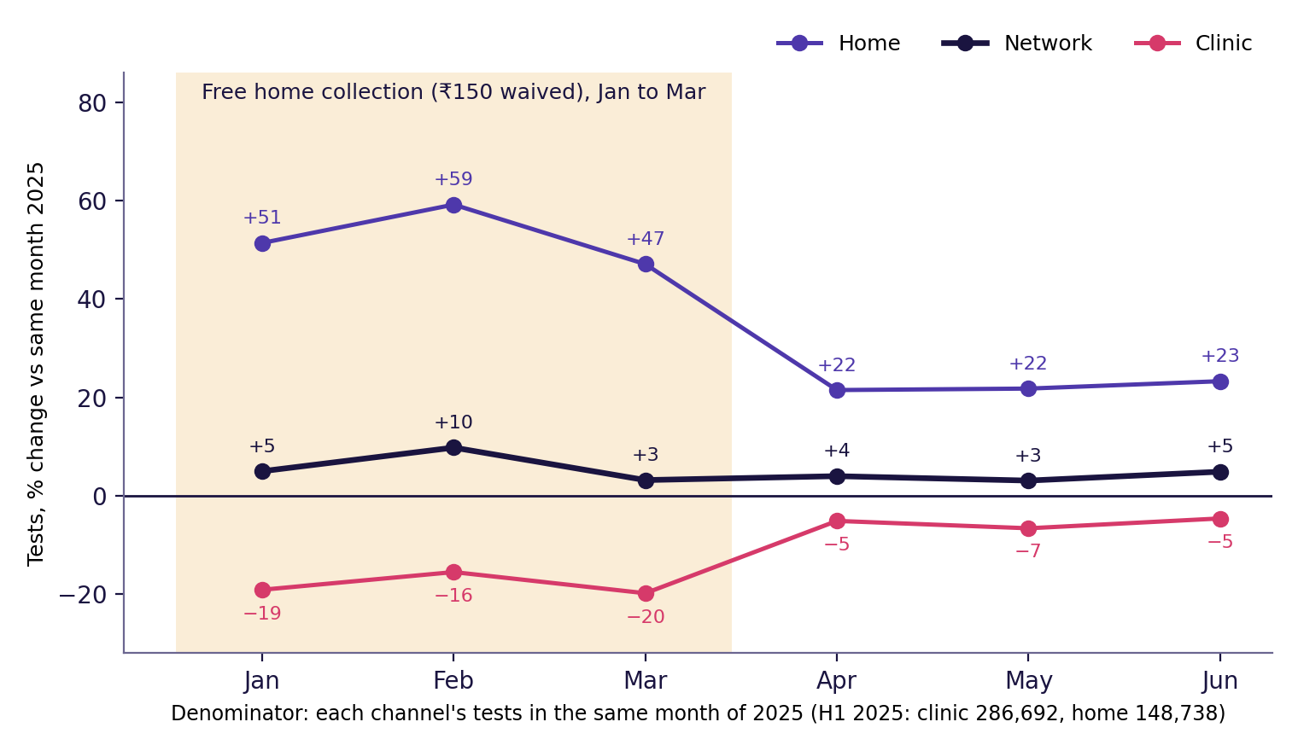
APPENDIX C
9 / 10
Appendix C · The free home collection window
Offer quarter (Jan to Mar): home +52.5%, clinic −18.1%, network +6.0% vs the same months of 2025.
After it (Apr to Jun): home +22.2%, clinic −5.4%, network +4.0%.
Read: the offer's footprint is a shift between channels. Network growth in the offer quarter ran only about 2 points above the quarter after.
Not proof of cause: no control group, and who used the offer is not yet tested.
Indian Institute of Technology Gandhinagar · PG Diploma in AI-ML and Agentic AI Engineering · Cohort 2 · Build 1
Notes:
Backup slide, Brief E link: shown only if the panel asks about the free home collection offer.

Slide 13
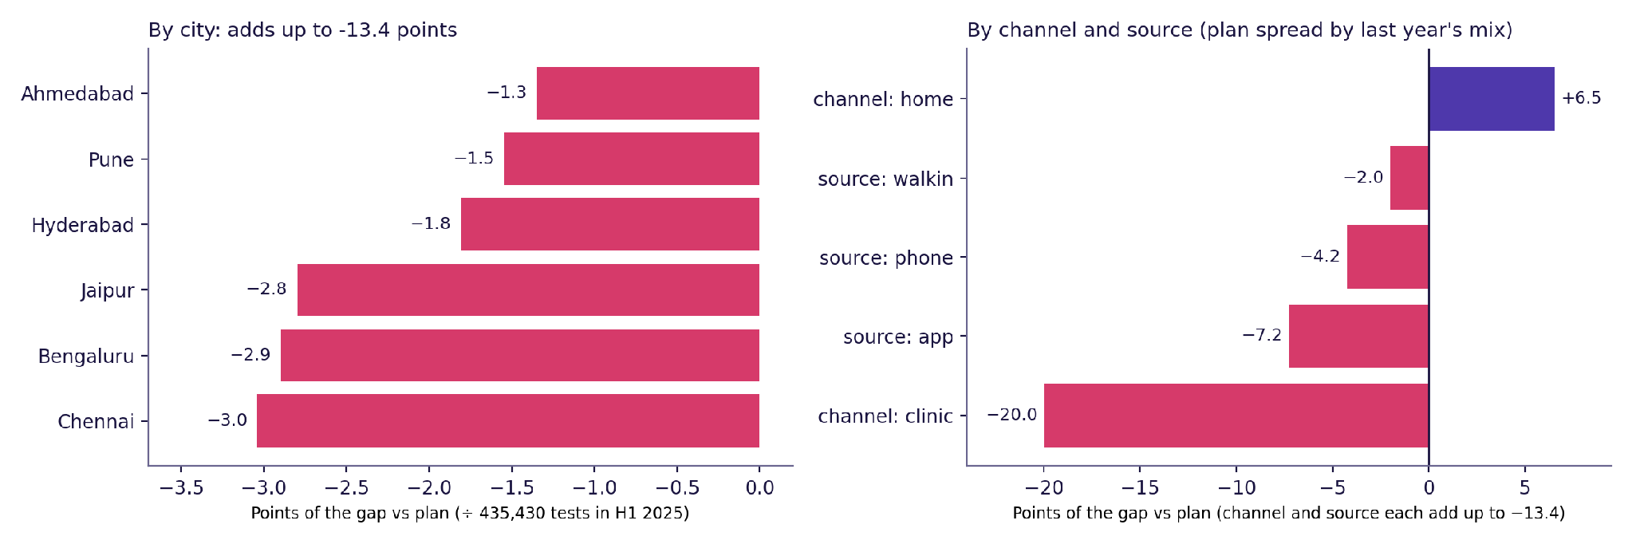
APPENDIX D
10 / 10
Appendix D · Where the 13.4 points sit
The plan has no channel or source split, so each city's plan is spread over its channels and sources in last year's mix (an assumption). Home met or beat that share in every city; clinic missed it in all six.
Indian Institute of Technology Gandhinagar · PG Diploma in AI-ML and Agentic AI Engineering · Cohort 2 · Build 1
Notes:
Backup slide: the 13.4 points by city, channel and source. Shown only if the panel asks where the gap sits.

Slide 14
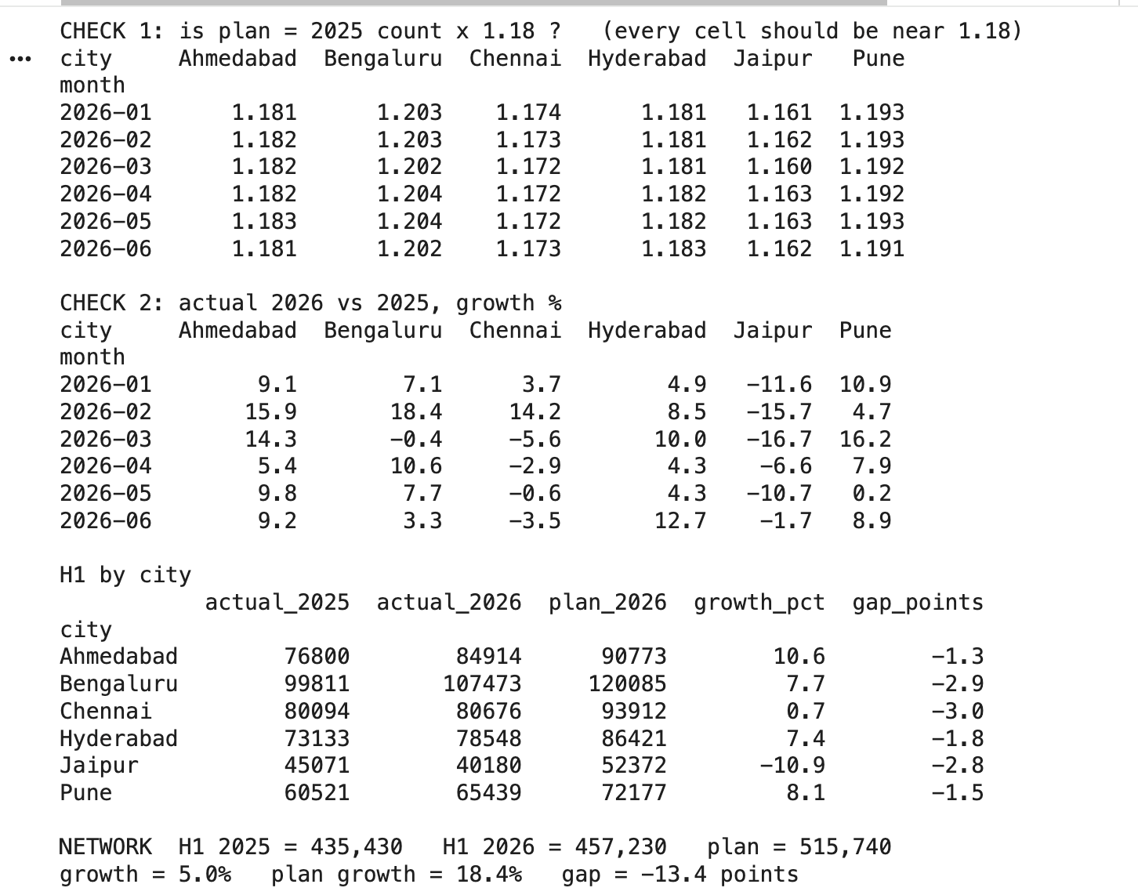
APPENDIX D
10 / 10
Appendix E · Where the 13.4 points sit
Indian Institute of Technology Gandhinagar · PG Diploma in AI-ML and Agentic AI Engineering · Cohort 2 · Build 1
Notes:
Backup slide: the 13.4 points by city, channel and source. Shown only if the panel asks where the gap sits.

Slide 15
